Slide 1


Microfinance Project
Submitted by: Nipam Nayan Gogoi

Slide 2
Business Problem Framing: Background:
A Microfinance Institution (MFI) is an organization that offers financial services to low income populations.
Mobile financial services (MFS) are more convenient, efficient, and cost saving than the traditional high-touch model when delivering microfinance services. The project:
Our client is a fixed wireless telecommunications network provider. They are collaborating with an MFI to provide micro-credit on mobile balances, to be paid back in 5 days. The sample data is provided to us from our client database. The client wants predictions that could help them improve their future investments through the accurate selection of viable customers.
There are 2 possible loan plans (in Indonesian Rupiah)
Loan amount | Payback amount
5 | 6
10 | 12

Slide 3
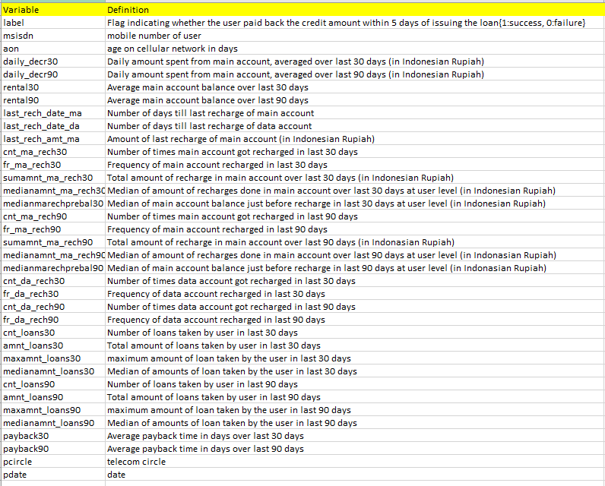
DATA CHARACTERISTICS:
Basic info:
209593 rows
37 columns
No null values present
Label is the target column

Slide 4
Data Preprocessing
Removed the categorical columns:- msisdn - mobile number of user, pdate - date, pcircle - telecom circle since these are irrelevant for the Analysis.
Outliers are removed based on Z-score.
The Dataset was Unbalanced. The label with 1 was 7 times that of 0. It was treated using Oversampling.
Further the data was scaled using Sklearn Standard Scaler before Model Building.

Slide 5
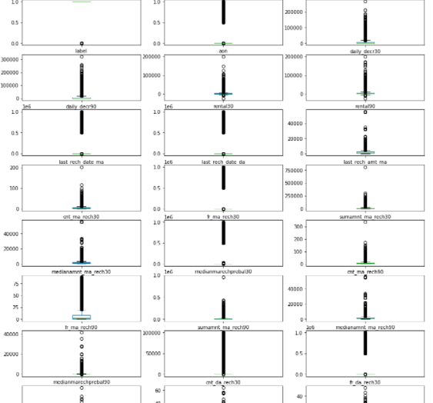
Data visualizations
Lots of Outlier in the Data

Slide 6
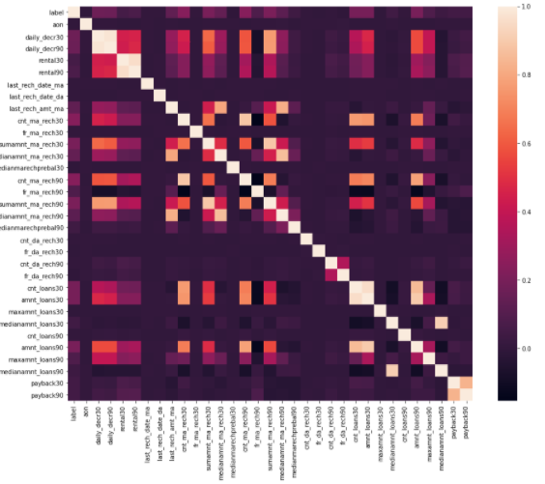
Data Visualization
Based on the heatmap many columns are somewhat correlated to the target column, but none are strongly correlated.

Slide 7
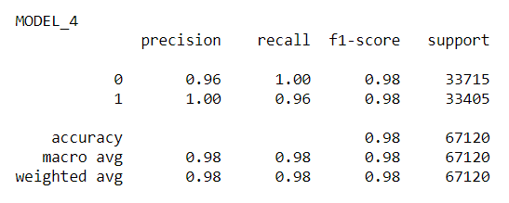
Model selection and Results The RandomForrestClassifier model was selected because it scored highest on the accuracy score.

Slide 8
Conclusion
The data contained outliers which was dealt using Outlier removal before Prediction.
It was an Unbalanced Dataset which was dealt using oversampling.
Based on the heatmap many columns are somewhat correlated to the target column, but none are strongly correlated.
Decision Trees and Random Forest, which is simply a collection of decision trees performed best on the dataset. The precision is accurate with zero False Positive(FP) values but recall is little bit less with a few number of False Negative(FN) values.
The Best model performed 98% accuracy on the unseen Test Dataset.

Slide 9
Thanks

